Slide 1
Web API Authentication
A Presentation by: Jacob Edward Russell Lipps
Notes:
Good evening guys.
So I think all of you know me.
I am Jacob Lipps.
But, I do not think you know my full name Jacob Edward Russell Lipps.
So a fun fact about me is that I have too middle names.
Edward and Russell.
Tonight my topic is going to be going over Web API Authentication also known as Web API Security.
Also, I will take any questions at the end of the presentation.
But, that’s enough about that lets go on to the topic at hand which is my presentation today which is Web API Authentication.

Slide 2
API
In computer programming there is an Application Programming Interface also known as an API.
It is a group of subroutine definitions, protocols and tools to put together an application software.
API is a group of very laid-out, defined methods of communication between different types of software types.
To have a good API makes the world a difference to creating a computer program by putting together all of the building blocks.
Put together by the programmer.
API’s can be used for a web-based system with an OS or operating system, with a DB or a database system, with computer hardware and a software library.
Notes:
Before we begin going into the Web API Authentication part I want to first address the API part so we can work off of the foundation before we go on to the technical side.
To start off what is an API and were is it used?
Well, an API is used in computer programming.
An API stands for Application Programming Interface.
What it is, is a grouping of subroutine of definitions and protocols and tools that are brought together for an application software.
But, to go into more detail it is a group defined through methods of talk between different types of software.
It is very important to have a good API, because in computer programming you have to combine all of the different building blocks.
Which is all put together by the programmer.
An API can be used with a web based system regarding an OS or an Operating System, a DB or a Database System, with keeping in mind with computer hardware and software library's.

Slide 3
API (Continued)
The API specifications can all be very different depending on its design purpose.
But most of the time API’s specifications have routines, data structures, object classes, variables and or remote calls.
POSIX, Windows API and ASPI are just some of the examples of the different forms that an API can take.
Notes:
Sill continuing with API.
API’s can be used for a wide variety of things. That there is almost no end to what it could be used for. That it was designed to be used for a lot of things and not fixed to certain purposes. That the makers made it so that there is an infant of possibilities that it could be used for.
In side of the majority of API’s there are routines, data structures, object classes, variables and or remote calls.
Some examples of the different software and or systems you can use to use API are POSIX, Windows API and ASPI.

Slide 4
API Documentation
One very important key with API is documentation.
I know that many Computer Science people do not like documentation and that it is very time consuming.
Which it is.
But it is vey important.
One of the reasons for this is so that when you hand the work over to another person, they are not just starting from scratch.
But it is a lot easier for them to read through the documentation and see what has been done and what needs to be done and how the work was done.
To see if there was any mistakes done.
If something happens in the future that you can look back in to the notes for what was done.
This is useful for the original person to look back on or if someone else was working on it.
Notes:
Now we move on to API documentation.
But, this just does not have to be about documentation for API, it could be for Web API and or Web API Authentication.
So, just in general for any of those three types documentation is very important.
So what do all Computer Science people hate?
Writing, such as writing reports and writing papers.
So like doing English classes and Humanities classes.
This is because it is very time consuming.
It truly is.
But, even though it is time consuming it is very important.
One large reason is when someone is working on a project and you pass the project over to the next person they are not just starting from scratch.
This is so that the new person can look through what has been done and what needs to be done.
But, more importantly with how the work was done.
This is because seeing how the work was done sees if there was any mistakes.
For example, if something happens in the future that you wondered why you did what you did or just what you did on a certain day or even just what you did then you can look back and find that out.
This can be helpful when you need to look back at something in the project you have been working on.
This can also be helpful when bringing in new employees or replacing an employee with another person so that new person can look over the information that has already been done.

Slide 5
API Summarized
API stands for Application Programming Interface.
Its definition is: a software intermediary that makes it so two applications can communicate with each other.
The focus is on the unique proposition of the application where outsourcing is used for all of the commodity functionality to the APIs.
Notes:
So now wrapping up on API I want you guys to remember that API stands for Application Programming Interface.
Then also I what you guys to remember what the definition of API is: which is a software intermediary that makes possible for two applications to talk with one another.
That with API the focus is on the special way that the applications are outsourced is used so the commodity functionality goes towards the API’s.

Slide 6
Web API
An Application Programming Interface (API) that could be used as a web server and/or a web browser.
The main purpose of Web API - it is available on the client side as well as the side of the server.
Helps to make web programming much easier by letting the programmers make their own web applications on top of the already in-place, high-level interface.
Notes:
So before we talk about and define Web API Authentication lets talk about Web API.
So Web API is an application programming interface other wise known as an API that could be used with a web server and or a web browser.
So with in that definition what is truly web API.
Well it is available on two sides it is available on the side of the client and on the side of the server which helps to make web programming not as hard which lets programmers build there web application on top of a very high level interface.

Slide 7
Web API Authentication Security
So what is Web API security all about?
It is about authenticating the programs and/or the users who are working with the web API.
Now that you have the API you need to secure it.
Securing it is the difficult bit.
It is difficult to AUTHN or authenticate it and AUTHZ or authorize it.
In a large environment, certain security measures need to be met.
To allow people to get to things on a “need to have access basis”.
All based off of the AUTHN and AUTHZ.
Notes:
So now what is Web API authentication.
Well it is authenticating programs for people who are involved in Web API.
There are different levels of security which we will get to in one moment.
So you have to secure the Web API and or the API.
This can be easy or this could be very hard.
This is because the easiest way of implementing a security feature can also be the weakest security feature, most of the time.
That authentication and authorization are the two main hardest tasks.
That also when we talk about authenticating it is mostly shown as AUTHN and when we talk about authorizing it is mostly shown as AUTHZ.
That in large corporations there are a lot of different rules for what security needs to be in place for different types of companies like for example if it is a bank or a pharmaceutical company.
That with authentication and authorization it is all about the need to make sure that it is on a “need to know basis”.

Slide 8
Web API Authentication Security (Continued)
It is extremely important to have the right AUTHN to allow the producers - the API’s services - to authentically figure out the who the customer is.
It is the clients and the calling programs in which the AUTHZ correctly identifies the level of the person and the information they are supposed to have.
All about authenticating programs for users who have and use web API.
There are different levels of security with different level of privileges of implementation. The easiness of the integration is also the weakest type of security.
Notes:
So I know that I have talked a lot about this on the previous slide but, I cannot stress enough how important Authentication is with security and some of you guys that have the cybersecurity minor know what I am really talking about.
That the API’s need to correctly identify the right users trying to enter a system.
As well as to know what information they can have and cannot have.
This is not just talking about the different levels in the government like regarding the FBI with the levels of classified, Secret, and Top Secret.
But, it could be.
But, this is talking about what tools and what information a certain employee can have regarding what there position is.
That the main point of this is to authenticate a program for its users.
Now on to those different levels that I talked about earlier.
We will start with the easiest type of security features you can implement and end with the highest type of security.
As mentioned before the easiest way is also the weakest way.

Slide 9
The Methods
There are three main ways to authenticate and to authorize:
Static string
Dynamic tokens
User-delegated tokens
Static strings are very similar to passwords that are put in place by the API for the user.
Dynamic tokens are set off of time from tokens that are retrieved by the caller from the authentication service.
User-delegated tokens are tokens that are like the OAuth, which is given on the grounds of a user authentication.
Notes:
Now we will go into the different types of methods.
There are three main different types of methods to authenticate and to authorize, they are:
Static string
Dynamic tokens
User-delegated tokens
So what are the Static strings?
Well they are very similar to passwords that are set up by the API for there customers.
So what are the Dynamic tokens?
Well they are based off of time tokens that a obtained by a caller from an authentication service.
So what are the User-delegated tokens?
Well they are tokens that are like the OAuth which are given on a basses on the correct user authentication.

Slide 10
Static Strings
Regarding the API caller or the user where there is a string for the token as the request.
The Static string is the most basic authentication.
Being the basic authentication is not very secure. The person’s password is sent via clear text and every package that is sent across is clear text.
This can be avoided if there is a secure lower-level protocol that is used such as SSL (Secure Socket Layer).
The SSL is used to encrypt the packets, so the packets are no longer vulnerable, such as when someone with a packet sniffer could just see the plain text.
Notes:
We will be looking more into the static strings.
What happens here is that the API caller or the user gets information in a string which is the token as the request.
As we talked about earlier with all the different levels of authentication.
This level is the most basic one.
Also, as we talked about that the lowest level of security is the weakest level of security is true here. This is because the passwords that a person uses is sent in clear text. For every single package that is sent is sent for anyone to read.
Now this can be avoided if a secure lower-level protocol is used.
Like for example SSL.
Which sands for Secure Socket Layer.
The SSL would defiantly be needed here to make sure that the packets are encrypted.
Which would help to make the packets not as vulnerable as before.
Because before someone with a packet sniffer could read any and or all of a persons packets sent across.

Slide 11


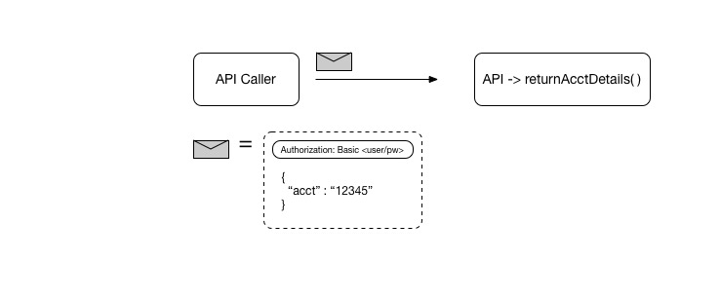



Notes:
Ok, here we have an example of the static string and you can probably see why it is the most basic authentication and is the basic authentication.
You have the API Caller with a message and the message is in plane text. It being 12345.

Slide 12
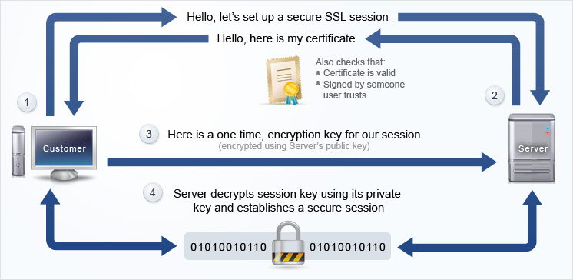
Notes:
This slide is regarding other ways to handle a static string more safly and in a more professional or business professional and common practice way.
So the way that the SSL session works is as follows:
The customer contacts the server.
Then the server sends out a certificate to the customer.
Then the customer sends the server the one time access code.
Then the sever takes the one time key and if it works the customer can asses the server for a period of time.
If it does not work then the customer cannot access the server.

Slide 13
Dynamic Tokens
An API being secured by this type of method is based off of the time-based, which is put into the token.
There is a TTL, otherwise known as “time to live,” which means that the token must get a new token.
This type of method uses an algorithm so when the token expires you are no longer able to access.
An example of a Dynamic token is JSON Web Token or JWT.
The exp part means expiration time which shows the expiration time at the point of expiration time or after the expiration time. At that point, the JWT cannot be accepted to do anything.
Notes:
Now we will more look into another level of authentication.
For this level with the API what happens is that there is a time-based that is put into the token. It is kind of like a time stamp.
There is a TTL or a time to live situation set up which after the TTL expires the person must obtain a new token.
With this type of API method having an algorithm that checks the time means that when the time runs out on the token you can no longer access what you need to access with that token.
An example of a Dynamic Token is a JSON Wen Token.
Which is also known as a JWT.
In the work expiration the exp part is referring to the time at which the expiration time has come about or after the expiration time has happened regarding at that time the JWT can no longer do anything.

Slide 14
JSON Web Token
Definition: a JSON-based open standard for making the access tokens that help with a lot of claims.
Example: So a server can make a token that says it “logged in as admin,” which would then be provided to the client.
This can be used as proof that the client logged in as administrator.
The tokens are signed into the server key so that the client and server can say that the token is authentic.
These types of tokens are made to be small, are URL-safe and cannot be used in a web browser single sign-on or SSO.
Notes:
We will be looking into more about the JSON Web Token now regarding the second level of security or the Dynamic Tokens.
So lets first look at the definition of what a JSON Wen Token is:
Well it is based off of JSON-based which is an open standard for access tokens that assists with claims.
Now lets look into an example.
That the server makes the token, that the server says that it is “logged in as admin” which is then shown for the client.
Then this can help will proof that that client did log in as administrator.
Which is because the tokens are logged into the server key which manes that the client and the server can officiahaly say that the token is authentic.
Now lets go into a little more detail about the type of token that the JSON Web Token really is.
That they are small tokens, that are URL-safe, which cannot be used in a web browser to single sign-on also known as SSO.

Slide 15
JSON Web Token (Continued)
The JSON Web Token or JWT is used most of the time to pass identity of authenticated users between the identity provider and a service provider.
These type of tokens can also be authenticated and encrypted.
JWT also works with other JSON-based standards:
JSON Web Signature
JSON Web Encryption
Notes:
So what is the JSON Web Token or JWT used for:
Well it is used for passing identity of authenticated users between identity providers and a service provider.
That using JSON Web Token can be authenticated and encrypted.
There are two other standards that work with JWT which are JSON Web Signature and JSON Web Encryption.

Slide 16
JSON Web Token (Structure)
There are three parts to a JWT:
A header
A payload
And a signature
The header – shows which algorithm is made to make the signature.
Example: header = '{"alg":"HS256","typ":"JWT"}’
The HS256 represents that the token is using the hash type SHA256.
Notes:
So there are three parts to the JSON Web Token:
A header
A payload
And a signature
So lets start with the header:
The header is about displaying the algorithm that is in charge of making the signature.
As you can see in the header example, we have the alg for algorithm then we have the HS256 which represents the hash type, then there is typ which stands for type which is the JWT or the JSON Web Token.
Then the HS256 represents the hashing algorithm of SHA256.

Slide 17
JSON Web Token (Structure) (Continued)
The payload – is regarding who has the right to make the request.
Example: payload = '{"loggedInAs":"admin","iat":1422779638}’
This shows with that the timestamp is iat and when it was made and or installed.
The signature – is figured out by using base64url which is encoding the header as well as the payload, which is then concatenated.
key = 'secretkey’
unsignedToken = encodeBase64Url(header) + '.’ + encodeBase64Url(payload)
signature = HMAC-SHA256(key, unsignedToken)
Notes:
The we have the payload:
Which is about who has the ability to make certain requests.
The example shows that the person “loggedInAs” well logged In As the admin or the administrator.
Were also that the iat represents the timestamp, which are the numbers that follow.
The iat as the timestamp shows when the timestamp was made and or when something was installed.
Then we go on to the signature part.
Which is about by base64url with encoding the header and the payload together.
Which is shown in the example:

Slide 18
User-Delegated Token
This type of token has a three-legged system where applications have to have the ability to reach the API for the user.
So that user ids and passwords do not have to be shown to the application, the user allows the token (which is encapsulated) so that the user has the right for the application to handle the API.
Under this type of token is the OAuth 2.0. This is an authorization framework that allows third-party applications to have some access to the HTTP service.
This can happen by the owner allowing there to be a connection between the owner and the HTTP service.
Or it could happen by allowing the third-party application to automatically get the access its needs by itself.
Notes:
Now we are going onto the third way that you can authenticate, which is using a User-delaged Token.
This type of system or token is were aplications are able to get to the API for the user.
This type of token keeps a persons credentials all hidden from the actual application.
For example when you log into Chase.com or a similar type of system and you enter your username and password the those credentials are never shown to the system.
Which is why when you loose or forget your password the company sends you a one time password or for a certain period of time for like 5 minuets that password works.
This is because the company does not have your password so they do not know what it is and so they can not send it to you.
So they send a temporary password.
Plus when handling this the user has to the power to give the API permission to do certain things or not do certain things.
Under the User-delegated token is a system called OAuth 2.0 which we will look more into in just one moment.
This OAuth 2.0 gives authorization to third-party applications to have access to the HTTP service in a secure manor.
One of the ways this can happen is by the physical owner giving permissions for the owner to connect with the HTTP service.
Another way for this to happen is by the owner turning on automatic access were the third-part application access things that it needs by itself.
Instead of the owner giving permission to every little thing that the application needs.

Slide 19
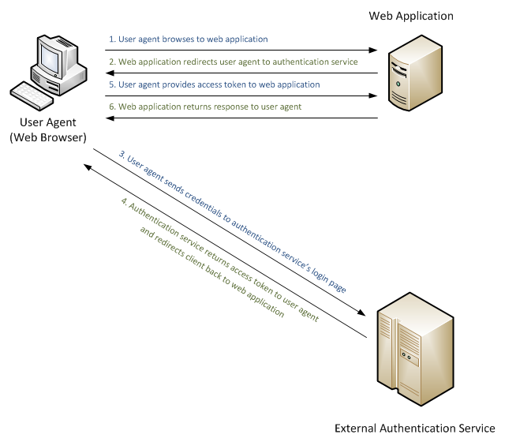
Notes:
So here we have a diagram without OAuth 2.0.
We have the User Agent which is the Web Browser, we have the Web Application and we have the External Authentication Service.
The first step is the (User agent browses to web application.
Then the (Web application redirects the user agent to the external authentication service).
Then the (User agent sends credentials to the external authentication service’s login page).
Then the (Authentication service returns the access token to the user agent and redirects the client back to the web browser).
Then the (User agent provides the access token to the web application).
Then lastly the web application returns the response to the user agent).

Slide 20
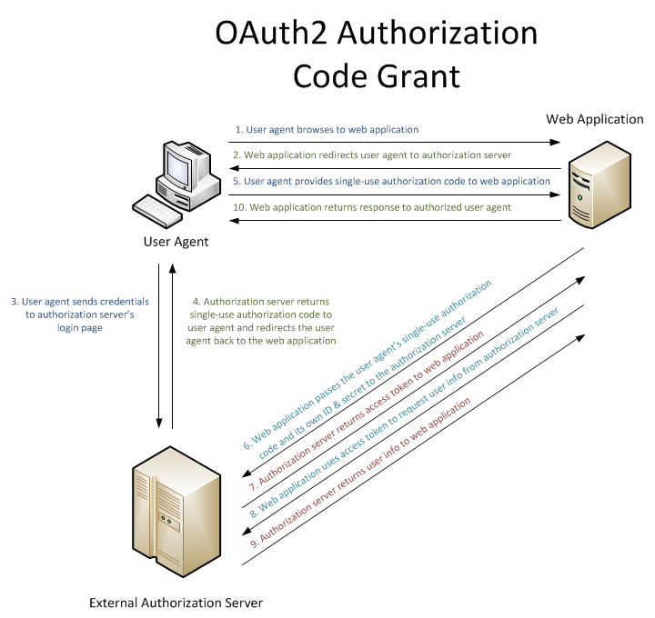
Notes:
Now we will look at how OAuth 2.0 works when we have that implemented.
Our first step is the same with the (User agent browses to the web application).
Our second step is also the same were the (Wen application redirects the user agent to the external authentication server).
The third step is also the same with the (User agent sends credentials to the external authentication server’s login page).
The fourth step is also the same with the (External Authentication server returns a single-use authentication code to the user agent and redirects the user agent back to the web application).
The fifth step is also the same with the user agent providing a single-use authorization code to the web application).
Now we have our differences with steps 6, 7, 8 and 9.
Were step 6 is the (Web application passing the user’s agent’s a single-use authorization code and its own ID and secret to the authorization server).
Were step 7 is about (External Authorization server returning the access token to the web browser).
Then step 8 is the (Web supplication uses a access token to request the user information from the external authentication server).
Were now step 9 is about the (External Authentication server returning the user information to the web application).
Then step ten is the same as the other diagram step 6 which is boths last step were the (Web application returns the response to authorize the user agent).

Slide 21


Any Questions?
Notes:
Now as I said earlier to hold all questions to the end now is the time to ask those questions.
So does anybody have any questions?

Slide 22

Thank You
Notes:
Now I what to thank you for all of you guys listening to my presentation and I hope all of you guys enjoyed my presentation and got something out of it tonight.
That I hope all of you guys learned something useful.

Slide 23
Bibliography
https://en.wikipedia.org/wiki/Web_API
https://en.wikipedia.org/wiki/Web_API_security#/media/File:Wiki_basicAuth.jpg
https://en.wikipedia.org/wiki/Application_programming_interface
https://en.wikipedia.org/wiki/Web_API_security
https://docs.microsoft.com/en-us/aspnet/web-api/overview/security/external-authentication-services
https://www.google.com/search?q=any+questions&source=lnms&tbm=isch&sa=X&ved=0ahUKEwjI0bDtmODZAhUCy1kKHTE4AcAQ_AUICigB#imgrc=NL0mrNGriodIPM:
https://www.google.com/search?q=any+questions&source=lnms&tbm=isch&sa=X&ved=0ahUKEwjI0bDtmODZAhUCy1kKHTE4AcAQ_AUICigB#imgrc=u-k8-bch5DTVBM:
https://www.google.com/search?q=thank+you&source=lnms&tbm=isch&sa=X&ved=0ahUKEwjHs7jMmuDZAhVhplkKHWY-A64Q_AUICigB&biw=1777&bih=854#imgrc=glUnsPafJS93VM:
Notes:
And now then this is my bibliography.
Thanks again and thanks form listening.

Slide 24
Bibliography
https://en.wikipedia.org/wiki/Web_API_security
https://www.cl.cam.ac.uk/~rja14/Papers/SEv2-c18.pdf
https://oauth.net/2/
http://unixpapa.com/auth/basic.html
https://tools.ietf.org/html/rfc7519
https://tools.ietf.org/html/rfc6749
https://en.wikipedia.org/wiki/Web_API
https://en.wikipedia.org/wiki/OAuth
https://en.wikipedia.org/wiki/Authentication
https://en.wikipedia.org/wiki/Application_programming_interface
https://en.wikipedia.org/wiki/JSON_Web_Token
https://en.wikipedia.org/wiki/Server_Application_Programming_Interface
https://www.asp.net/web-api
https://www.google.com/search?ei=Fz6wWqiiHI_Z5gLOjaGgCA&q=api+definition&oq=api+definition&gs_l=psy-ab.3..35i39k1j0l7j0i20i263k1j0.9432.14721.0.15444.22.18.4.0.0.0.122.1625.3j12.16.0....0...1c.1.64.psy-ab..2.20.1894.6..0i67k1j0i131k1.128.PyC8JOzmasA
https://www.youtube.com/watch?v=s7wmiS2mSXY
https://www.google.com/search?ei=KD6wWo2BE_Lm5gLcioeIDw&q=web+api+definition&oq=web+api+definition&gs_l=psy-ab.3..35i39k1j0i7i30k1j0i5i30k1l2j0i8i30k1l3.98085.98823.0.99788.4.4.0.0.0.0.312.515.1j1j0j1.3.0....0...1c.1.64.psy-ab..1.3.513...0i8i7i30k1j0i7i5i30k1j0i5i10i30k1j0i8i10i30k1.0.lj1JCUEwvms
http://www.dotnettricks.com/learn/webapi/what-is-web-api-and-why-to-use-it-
https://msdn.microsoft.com/en-us/library/hh833994(v=vs.108).aspx
https://docs.microsoft.com/en-us/aspnet/web-api/overview/security/individual-accounts-in-web-api
https://www.asp.net/web-api/overview/security
http://www.dotnetcurry.com/aspnet/1223/secure-aspnet-web-api-using-tokens-owin-angularjs

